Slide 1
Summary of the PowerBI Dashboard / Repor

Slide 2
Data Preparation using Python
Initial of 2,044,643
Drop rows with passenger counts where = 0 as only 94 records
Drop rows with invalid ratecodeID (99) as only 2 records
Drop 1 row with highest fare amount of $538,579.20 as it is observed to be anomaly with 0 trip distance
Drop 1,017 rows whereby fare amount or other amounts are less than 0
Total of 2,043,531 rows left

Slide 3
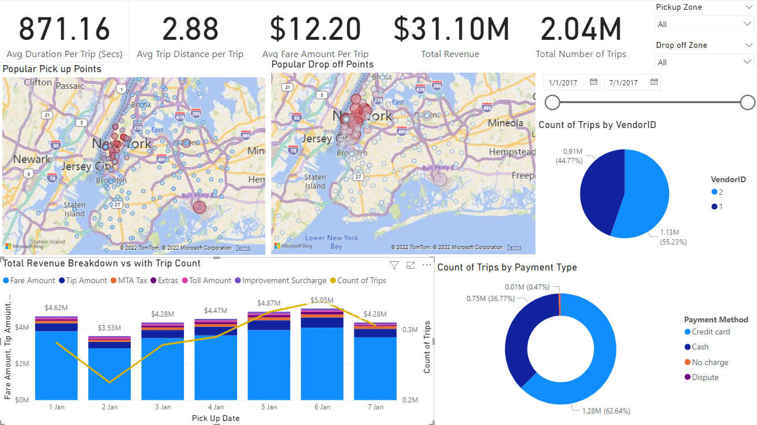
Analysis on KPI Indicators where it can be filtered to find out the metrics per day or location
Filters for dashboard
In addition, each chart can be also used as filters
Geospatial analysis on Pick Up and Drop off Points
Size of Bubble indicates total revenue from the pickup/drop off point and color highlights the number of trips. (Red is most) Areas such as Midtown Center, Mathattan are popular for drop offs and pickups. Noteably, there are also a number of pick up and drop off at the airports.
Market Share Analysis
Vendor 2 has slightly more market share in the industry
Payment Type Analysis
Trips are usually paid with credit card (62%) and cash (37%)
Time Series Revenue and Number of Trips Analysis
Revenue consists mostly of the fare amount and tip amount, whereby Fridays (6 Jan) is the most profitable of the week.

Slide 4
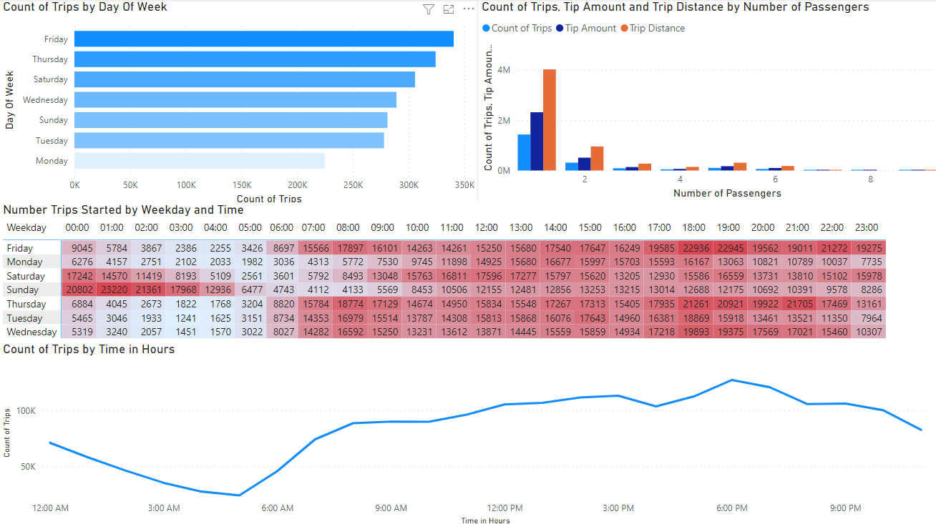
Trip Analysis by Day of Week
Fridays comprises of the most amount of trips followed by Thursday
Trip Analysis by Passengers
Most rides consists of 1 to 2 passengers whereby the count of trips are in line with the tip amount, trip distance
Trip Analysis by Day of Week and Time
Saturday and Sundays are most busy from 00:00 to 04:00. Demand increases and peaks at 6pm before trending down across all days.
Trip Analysis by Time of Day
Most trips are starting from 6 – 9 pm across the days. The number of trips started at 5 am is the lowest.

Slide 5
Recommendations
More taxi resources can be:
Taxi fleet to be located at places in Manhattan as these are the most popular drop off and pick up spots
Taxi fleet to cater for more ramp up capacity on Thursdays, Fridays, Saturdays
Taxi fleet to cater for demand increases and peaks at 6pm before trending down across all days.
Larger taxis can be reduced in the fleet as the most frequent passengers count are 1 and 2.

